Slide 1
Web Development
Layout design using CSS

Slide 2
Content
Structuring your layout, inc. wireframes
The Box Model
Positioning using CSS
Creating page layouts using CSS
Responsive Web Design

Slide 3
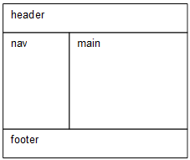
Page design - wireframes
A visual representation of an interface
Helps both design and conceptualisation
Communicates
Page structure
Content layout
Functionality, behaviour
A very basic example

Slide 4
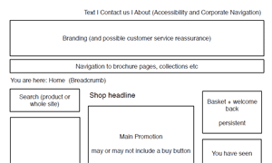
Wireframe fidelity / definition
The level of detail / definition
Low fidelity
Block diagrams
Good for initial testing of layout and getting feedback

Slide 5
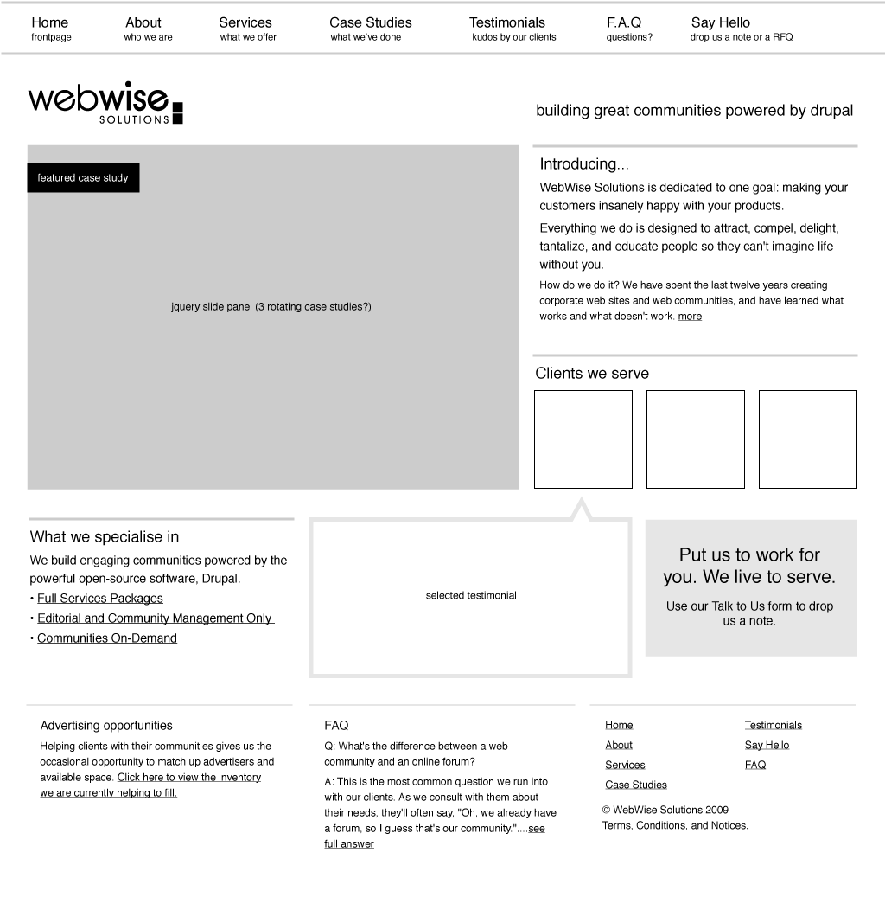
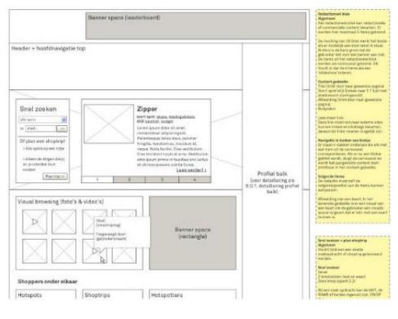
Wireframe fidelity / definition
Hi fidelity
Detailed layout
Can include a detailed commentary / design notes with styling information and can describe behaviour

Slide 6
Applying structure
In html5, using sections, nav, articles etc. to group elements
<section> <h2>A Heading</h2> <p>Text in a paragraph …</p> </section>
Using divs to group only if no semantic meaning <div> <p>Text in a paragraph …</p> <p>More text …</p> </div>

Slide 7
Structuring your layout
The first step is to create a logical page structure
Divide the page into logical sections (e.g. using the section, nav, footer, aside, main, article or div)
Put the sections in a logical order
Use headings (h1, h2, h3 etc)
Provide CSS styles for each section
HTML file
CSS file
<nav>
nav
main
footer
<main>
<footer>

Slide 8
Positioning elements
Page flow
Box model
Float
Flex
Grid
Position: static, relative, absolute, fixed

Slide 9
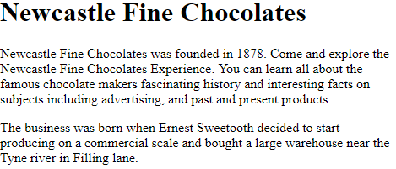
Normal flow
<h1>Newcastle Fine Chocolates</h1>
<p>Newcastle Fine Chocolates was founded in 1878...</p>
<p>The business was born when Ernest Sweetooth….</p>
h1
p
p
By default browsers
display page elements in the order they are coded. Block elements stack up one upon another and occupy full page / container width

Slide 10
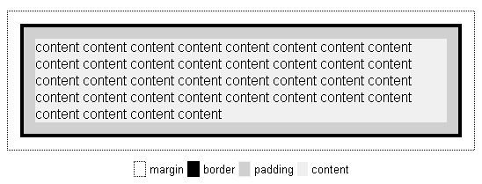
The Box Model
Every element is considered to be inside an invisible rectangular box
Each box consists of content surrounded by padding, a border and margins
Remember:
When you specify the ‘width’ of an element you’re specifying the width of the content.
The actual computed width which the element occupies is the
content width + (padding x 2)
+ (border x 2)
+ (margin x 2)

Slide 11
Positioning using CSS
Allows you to specify the location (the “box”) of elements on the page
You can do this
By “floating” them
By using flex
By using grid
Relative to where they would be under normal flow
To the absolute pixel value (taking them completely out of normal flow)

Slide 12
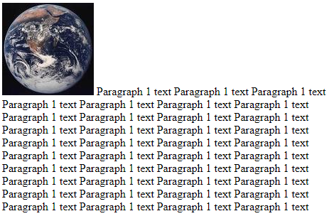
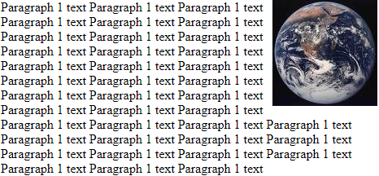
CSS floating
Uses the CSS float property
browser renders page using normal flow and then
float moves an element as far as possible to the left or right of its parent element
other content flows (wraps) around it
Under normal flow
Image floated to the right

Slide 13
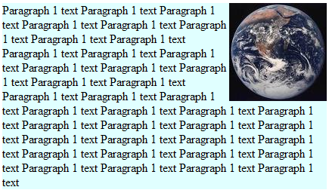
CSS floating example 1
<p>
<img class="planets" src="images/earth.jpg"
alt="Image of the Earth">
Paragraph 1 text Paragraph 1 text ...
</p>
.planets {
float: right;
}
p {
background-color: #E0FFFF;
}
Here the image is moved (“floated”) as far as possible to the right of its parent (the p)
The other (“non-floated”) page content flows (wraps) around the floated image

Slide 14
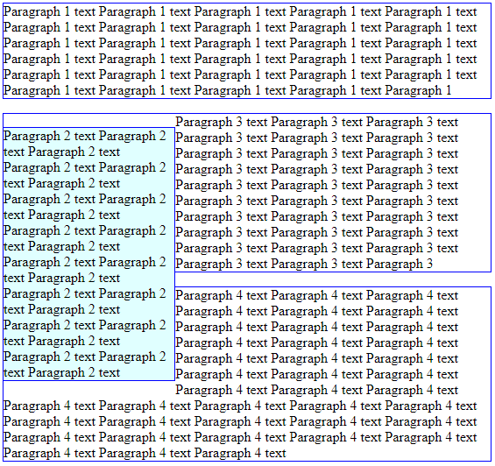
CSS floating example 2
In the last example we floated an inline element. Here we show a floated block element
Again the other content flows around it
Need to provide a width

Slide 15
Flexbox (flex)
Designed to allow for column or row layout
Good if you want multiple elements next to each other
To use it
You group child elements (flex items) in a flexible parent container and apply the CSS display: flex; to it
Then specify if the children should align horizontally side by side (form a row) or vertically under each other (form a column) using flex-direction (with values row or column)
Advantages include
adaptive, that is it resizes well for a fluid layout
ability to make neighbouring items the same height
can change the order that items display compared to the source order
E.g. for menu bars, product listings, galleries etc.

Slide 16
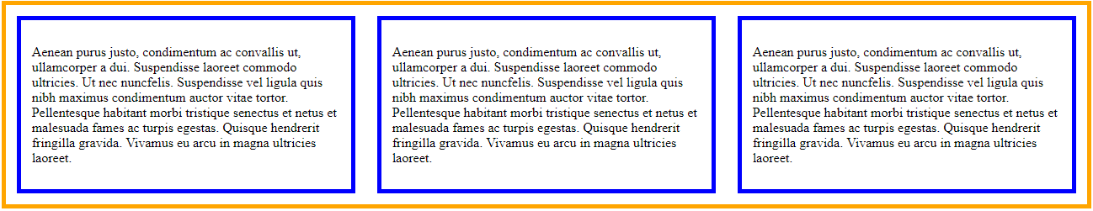
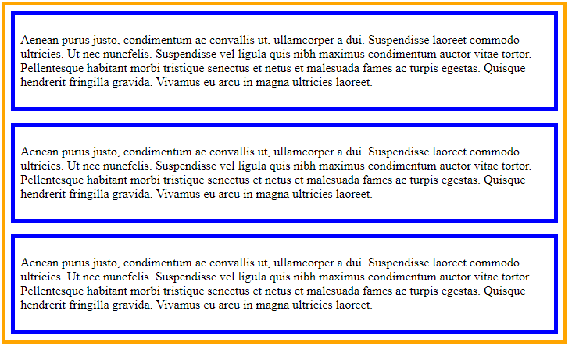
Flex examples
Row
display: flex;
flex-direction: row;
Column
display: flex;
flex-direction: column;

Slide 17
Flex examples
How can we make it vertical?
<nav>
<ul>
<li><a href="#">Home</a></li>
<li><a href="#">News</a></li>
...
</ul>
</nav>
nav ul {
display: flex;
flex-direction: row;
list-style: none;
…
}

Slide 18
Flex-based full page layouts
Flexbox is most suitable for putting items in a line (e.g., for navigation bars, product “cards” etc.)
However, you can use it to create fluid full page layouts (although eventually CSS Grid Layout may be better suited for that)
For example, how can we use flex to get the following?
How could we use the order property?
<header>
<header>
wrapper
wrapper
<nav>
<main>
<nav>
<main>
<aside> - news
<footer>
<footer>

Slide 19
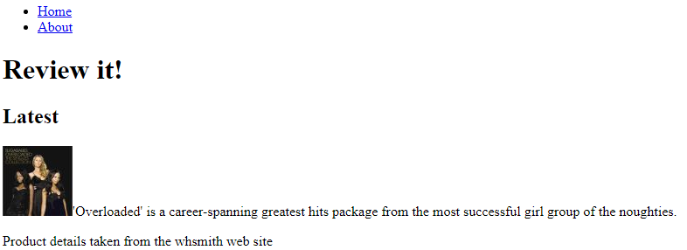
Flex - two column layout ex
<nav>
…<a href = "#">Home</a> …
</nav>
<header>
<h1>Review it!</h1>
</header>
<main>
<h2>Latest</h2>
<p><img src ="Sugababes.jpg" …>'Overloaded' …</p>
</main>
<footer>
<p>Product …</p>
</footer>
This HTML will display as follows under normal flow
nav
header
main
footer
Each major section (grouped area) is shown with a border. We will position them later

Slide 20
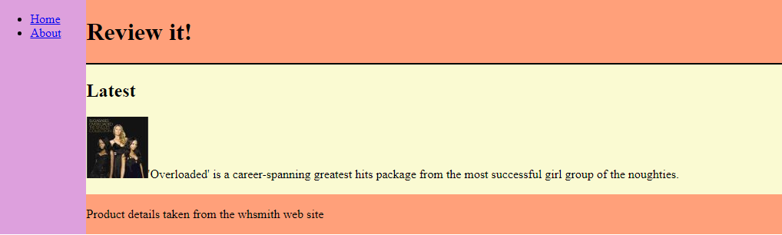
Flex: two column layout ex
<div id="flexParent">
<nav> <!-- child element -->
<a href = "#">Home</a> …
</nav>
<div id="content"> <!-- child element -->
<header>
<h1>Review it!</h1>
</header>
<main>
<h2>Latest</h2>
<p><img src ="Sugababes.jpg" … >'Overloaded' …</p>
</main>
<footer>
<p>Product …</p>
</footer>
</div>
</div>
Create an html flex parent “wrapper” with the CSS:
display: flex;
flex-direction: row;
header
nav
main
footer
nav is one child element – the first column. Set width using CSS
Place another html “wrapper” around the header, main and footer areas to make a second child element – the second column. Set width?

Slide 21
When to use float or flex
Float is the best way to make a single element move to one side and allow other content to flow around it
Flex is best for making multiple elements be side by side, or, one above another

Slide 22
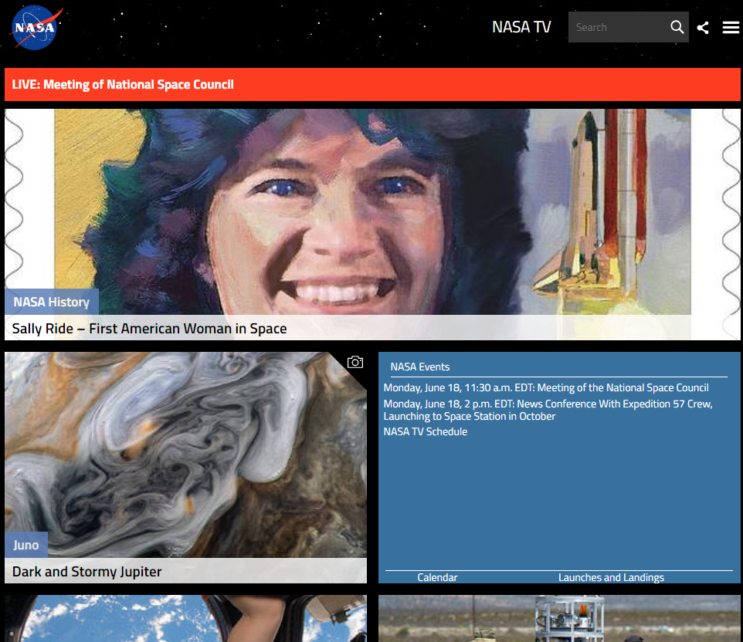
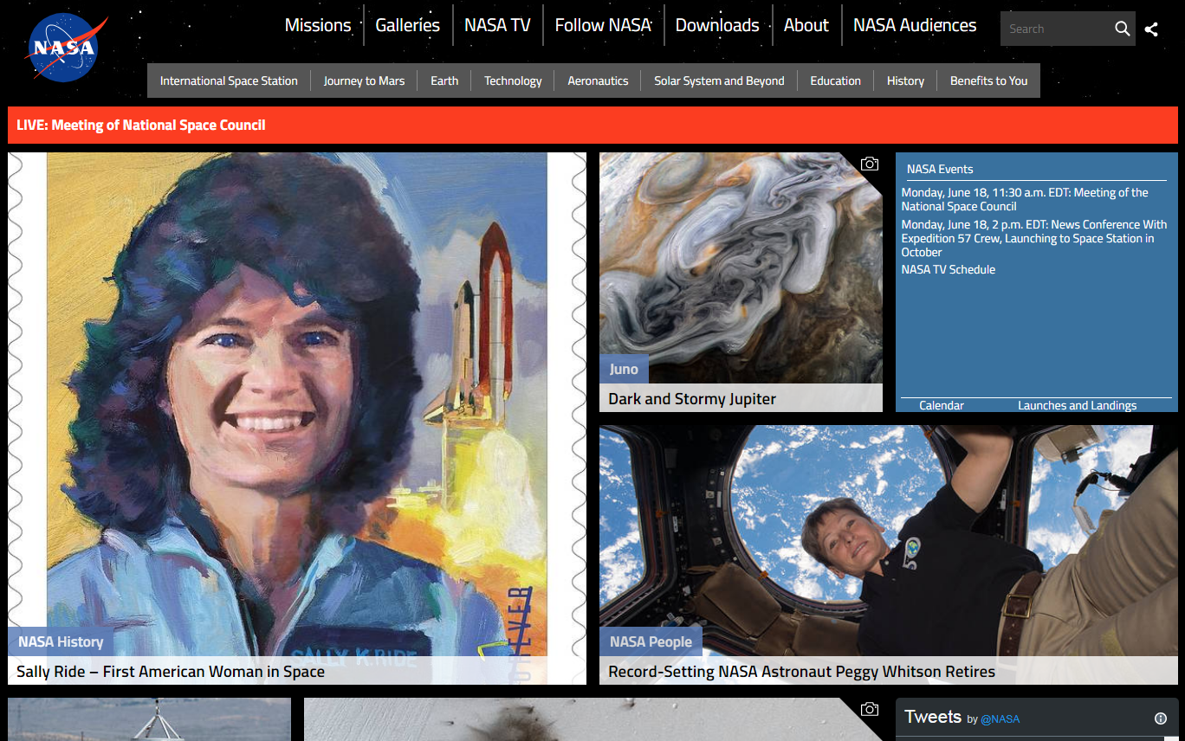
Responsive Web Design
A strategy to provide suitable layouts for different devices and screen sizes (e.g. mobile, tablet, desktop)
All get the same HTML for all, but we apply different CSS to it based on screen size using CSS media queries
Note that it is also important to design pages to work well on a continuum of every screen width in between by using a flexible fluid design (by applying, e.g., flex)

Slide 23
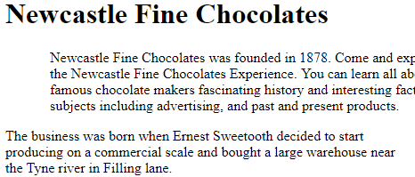
Relative positioning
Remember:
You almost never use relative position in order to position.
It’s mostly used to create a ‘positioning context’ for absolute positioning, which is explained next.
Under normal flow
<h1>Newcastle Fine Chocolates</h1>
<p id="firstP">Newcastle Fine Chocolates was founded in 1878...</p>
<p>The business was born when Ernest Sweetooth….</p>
h1
p
p
#firstP {
position: relative;
left: 50px;
}
With relative applied
CSS properties:
position: relative
With either left, right and bottom or top

Slide 24
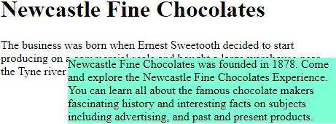
Absolute positioning – out of normal flow
With absolute positioning, the measures are offsets from the element’s “positioned parent” and if it doesn’t have one from the body element.
<h1>Newcastle Fine Chocolates</h1>
<p id="firstP">Newcastle Fine Chocolates was founded in 1878...</p>
<p>The business was born when Ernest Sweetooth….</p>
#firstP {
position: absolute;
left: 100px;
top: 90px; …
}
Because the first paragraph is now positioned absolute it’s not in the document flow so the second doesn’t ‘know’ it’s there and moves up, causing an overlap.
CSS properties:
position: absolute
With either left, right and /
or top

